Slide 1

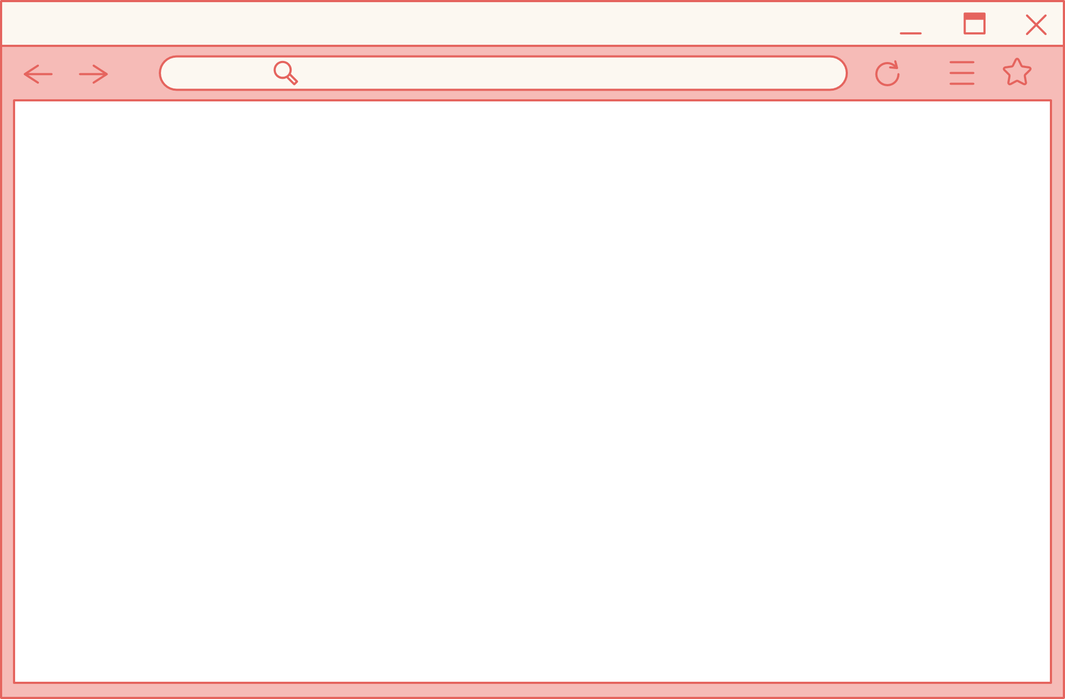

HOLA FASTFOOD STORE MANAGEMENT
DESKTOP APPLICATION
LAI VU HAI ANH - HE182182

Slide 2

CONTENT
FASTFOOD STORE MANAGEMENT PROJECT
DESIGN SPECS
SUMMARY
CONCLUSION

Slide 3
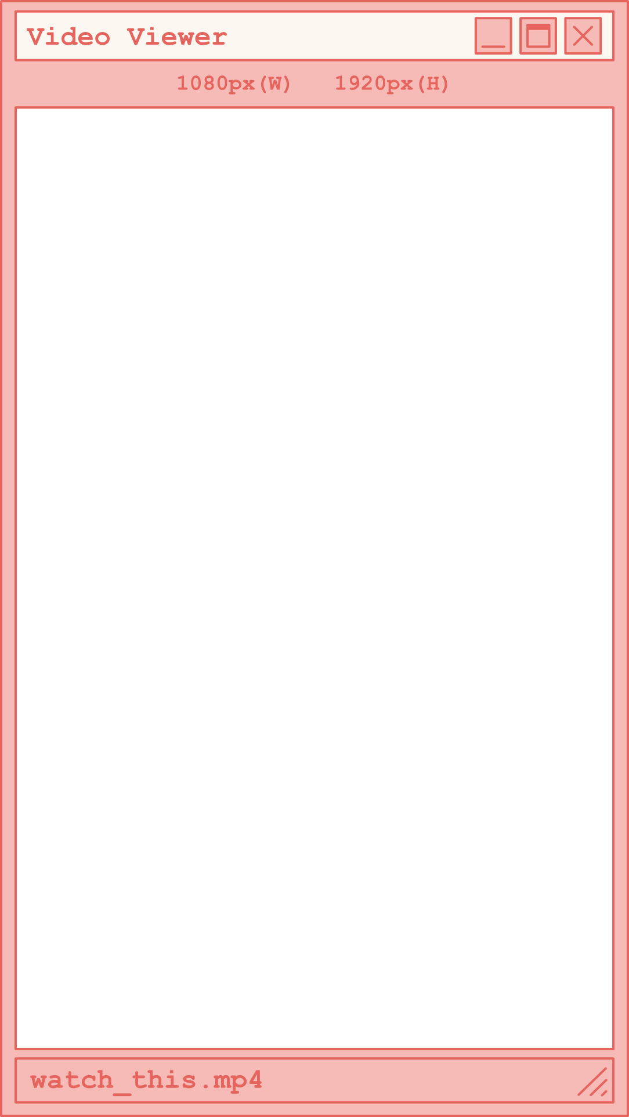
1. REASON FOR CHOOSING TOPIC
Managing a fastfood store involves a wide array of tasks, including
Inventory management, order processing, and customer service.
Streamline operations, improve efficiency, and enhance the overall customer experience, making it a valuable tool for fastfood owners and managers.
2. OBJECTIVE
EXECUTIVE
SUMMARY
·Supply inventory management in easier way.
·Simplify order processing to reduce wait times and errors.
·Provide detailed sales upon bills within a certain period to aid in decision-making.
3. TOOLS & TECHNOLOGIES
·Programming Languages: C# - for its powerful desktop application capabilities using .NET framework).
·Frameworks: .NET 8.
·Database Management: MySQL for local data storage.
·Integrated Development Environments (IDEs): Visual Studio 2022 for C#.
Version Control: Git for source code management

Slide 4
1. DATABASE DESIGN
ACTORS AND UTILITIES
STAFF: ADD OR REMOVE FOOD IN THE TABLE; PROCESS BILL
MANAGER: MANAGE ACCOUNT; MANAGE FOOD; MANAGE BILL,
DESIGN SPECS
2. OBJECTS & ENTITIES
One food category can have many dishes, but one dishes has only one category.
One bill info can have many dishes and only goes with one bill.
One bill can go with only one bill info, only one staff member and only one table.
One staff can process many bills.

Slide 5
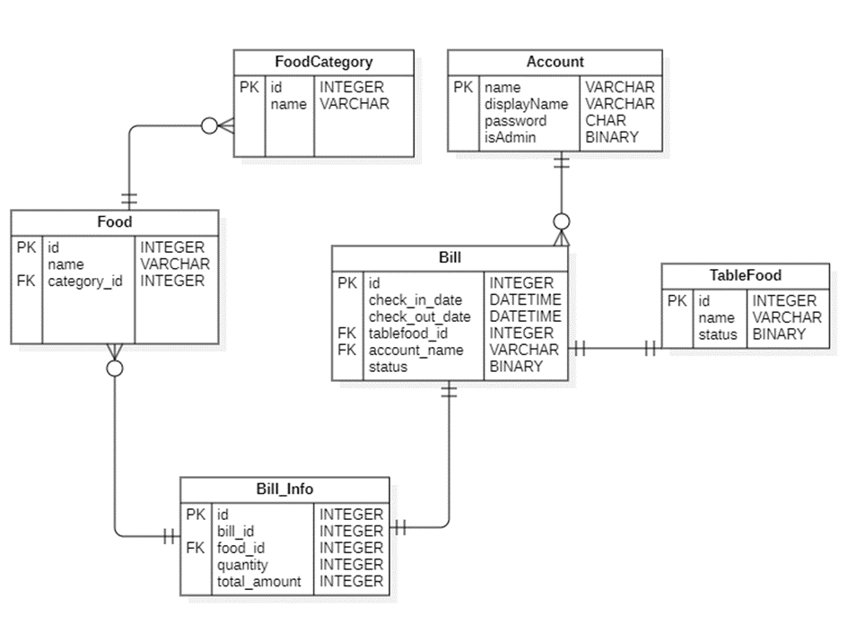

Slide 6
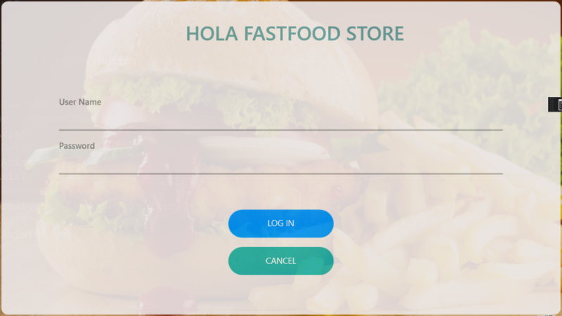
LOG IN
USER
INTERFACE

Slide 7
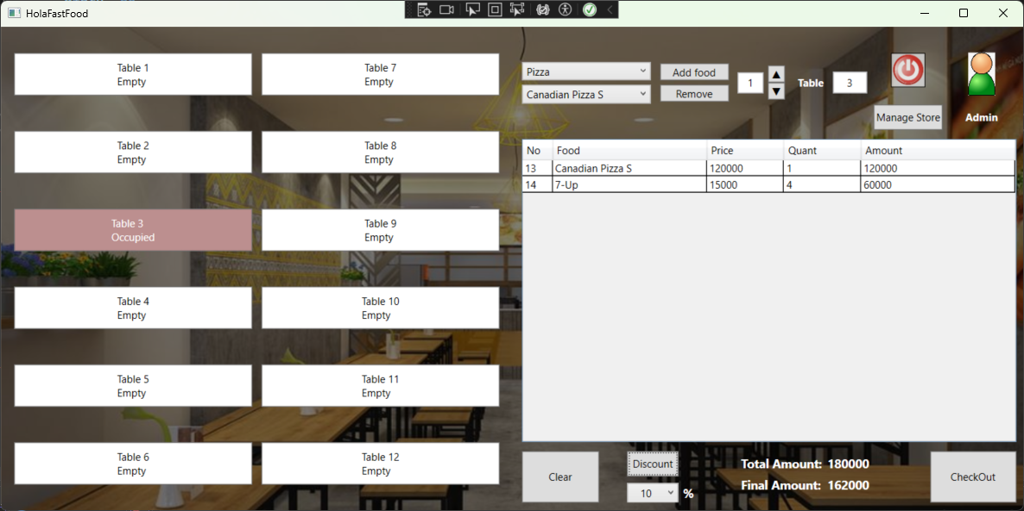
2. MAIN SCREEN
USER
INTERFACE

Slide 8
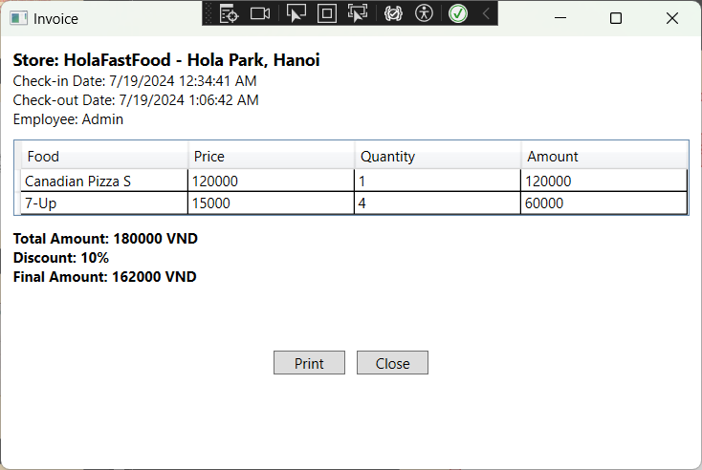
3. Invoice
USER
INTERFACE

Slide 9
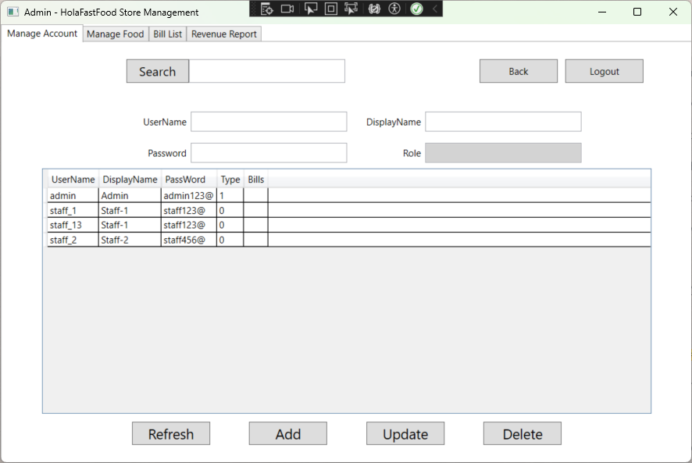
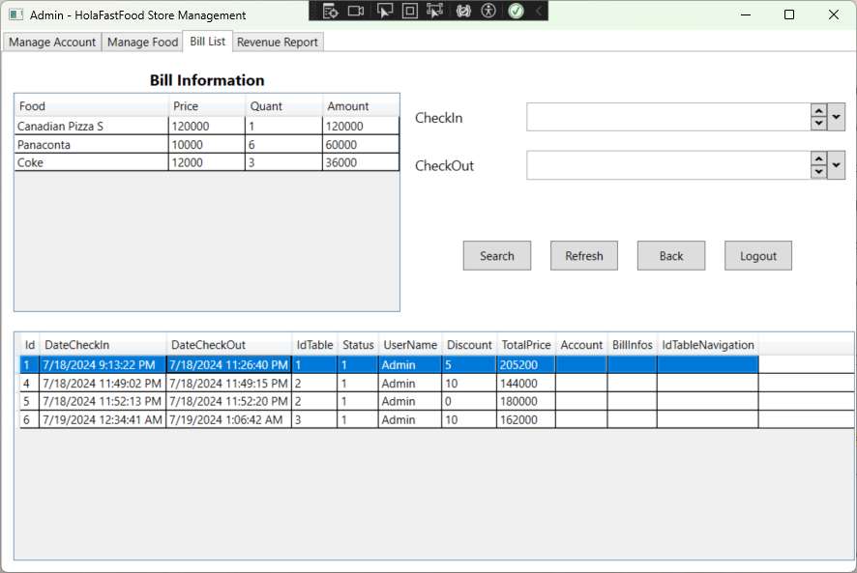
4. Manage Screen
USER
INTERFACE

Slide 10
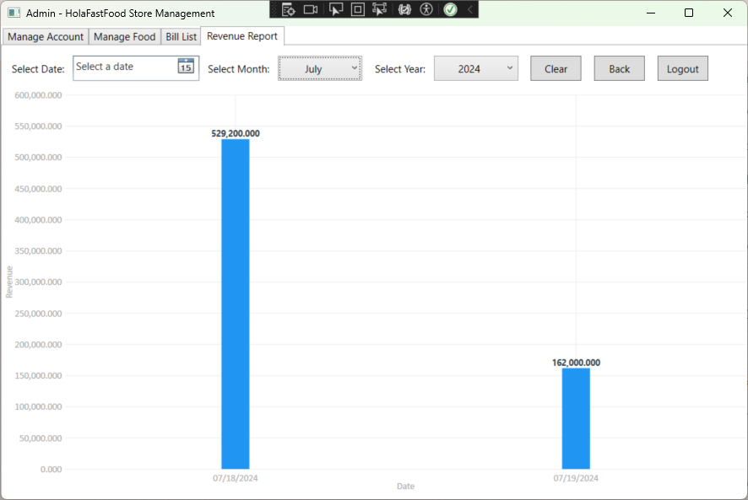
5. Report Screen
USER
INTERFACE

Slide 11
Positive Consequences
Operational Efficiency: Automating various tasks streamlines operations, reduces workload, and allows staff to focus more on customer service.
Enhanced Customer Experience: Quick and accurate service, flexible order management, and efficient payment processing contribute to a better customer experience.
Data-Driven Decision Making: The application can provide valuable insights through data collection and reporting, aiding in informed decision-making.
CONCLUSION
Negative Consequences
System Dependency: High dependency on the system means that any downtime or technical issues can severely disrupt operations.
Implementation and Maintenance Costs: Developing, implementing, and maintaining the application involves costs that need to be justified by the benefits.
FUTURE IMPROVEMENT TENDENCY
Integration with Mobile and Web Platforms
Cloud-Based Solutions
Enhanced User Interface (UI) and User Experience (UX)

Slide 12


THANK YOU

